Slide 1
Bio& 241 A&P
Unit 4 Lecture 4

Slide 2
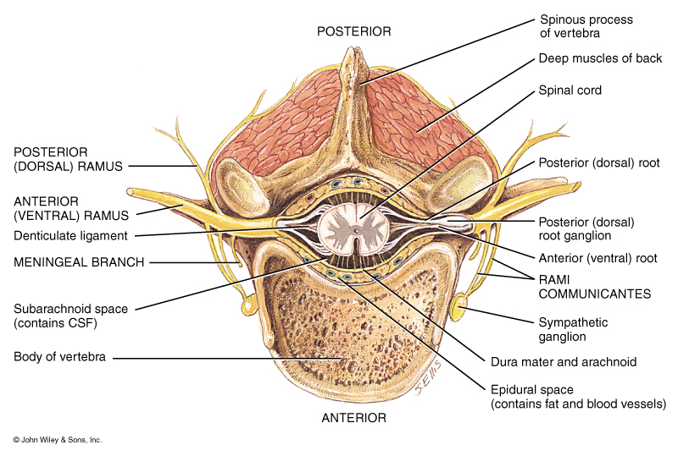
Position of the Spinal Cord in relationship to the Vertebral Foramen

Slide 3
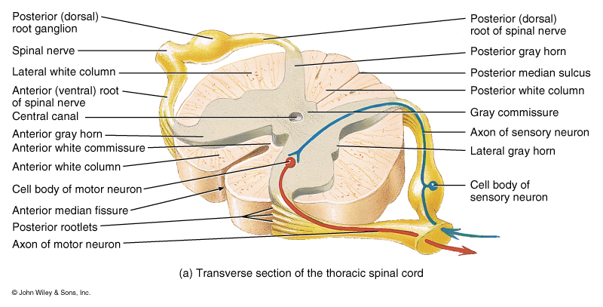
Gross Anatomy of the Spinal Cord

Slide 4
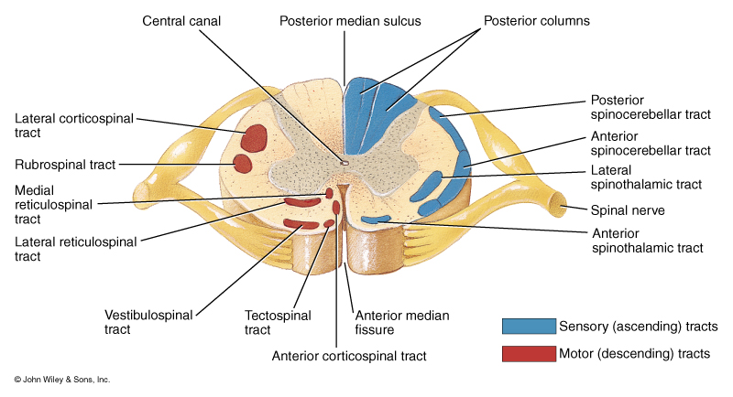
Ascending and Descending Tracts
of the Spinal Cord

Slide 5
Spinal Nerves
Cervical nerves 8 pairs
Thoracic Nerves 12 pairs
Lumbar Nerves 5 pairs
Sacral Nerves 5 pairs
Coccygeal Nerves 1 pair
Total 31 pairs

Slide 6
Spinal Plexuses and Nerves
Cervical Plexus (C1-C5)
Phrenic nerve
Brachial Plexus (C5-T1)
Axillary nerve, Radial nerve, Ulnar nerve
Lumbar Plexus (L1-L4)
Femoral nerve, Genitofemoral nerve
Sacral Plexus (L4-S4)
Sciatic nerve, Pudendal nerve

Slide 7
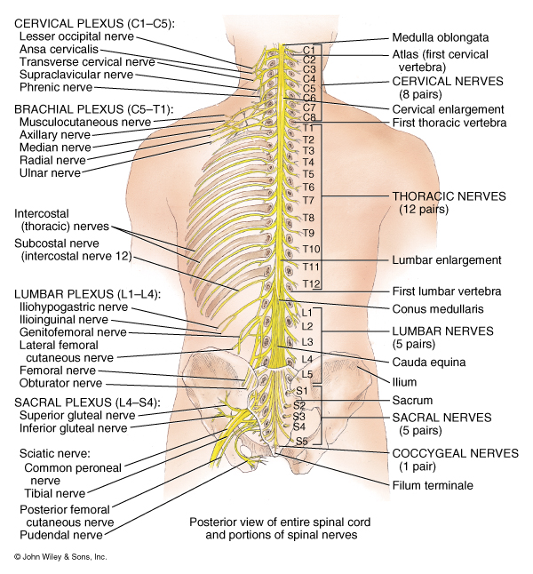

Slide 8
Spinal Nerves from the Cervical and Brachial plexuses
Nerve | Distribution
Phrenic | Diaphragm
Axillary | Deltoid, teres minor
Radial | Triceps brachii, extensor of the forearms
Ulnar | Flexor carpi ulnaris, skin of the medial side of hand, 5th finger, medial half of 4th finger

Slide 9
Spinal Nerves from the Lumbar plexus
Nerve | Distribution
Genitofemoral | Cremaster muscle, skin over middle anterior surface of the thigh, scrotum and Labia majora
Femoral | Flexor muscles of thigh, leg extensor muscles, skin over anterior and medial thigh, medial leg and foot

Slide 10
Spinal Nerves from the Sacral plexus
Nerve | Distribution
Sciatic | Combination of two nerves, tibial and common peroneal, innervates most of lower leg.
Pudendal | Muscle of the perineum, skin of the penis and scrotum, clitoris, labial majora, labial minora, and vagina

Slide 11
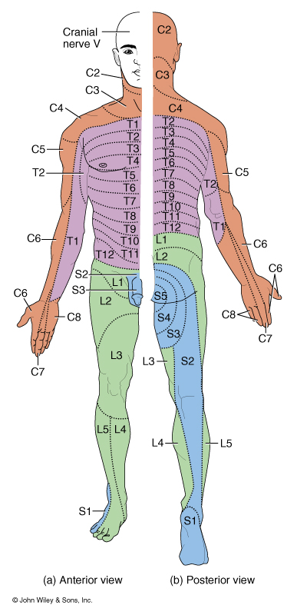

Slide 12
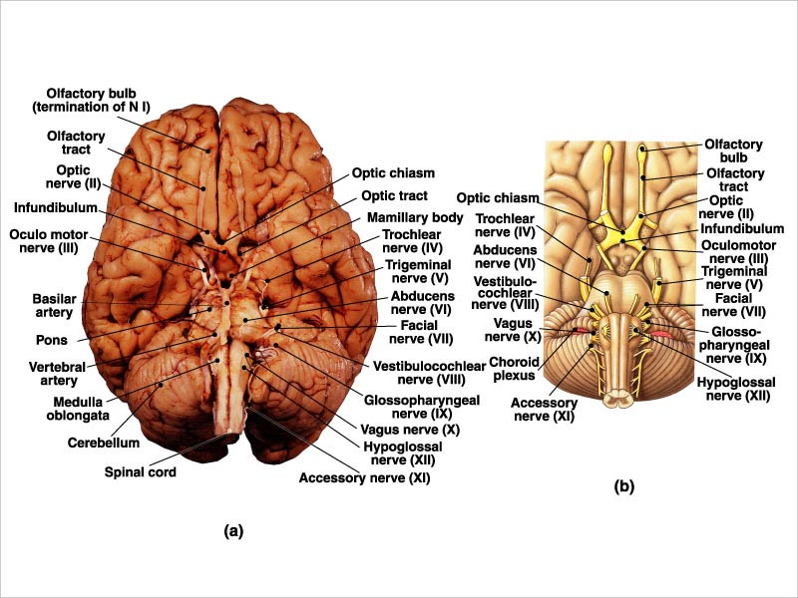
Review of Cranial Nerves

